Slide 1
BOM, DOM, AJAX, JSON

Slide 2
BOM
DOM
JSON
AJAX

Slide 3
JS BOM
Browser Object Model

Slide 4
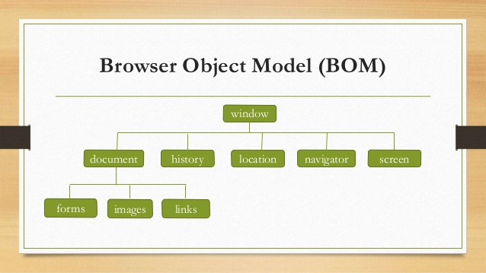
JS BOM

Slide 5

Window Object
The window object represents an open window in a browser.
If a document contain frames (<iframe> tags), the browser creates one window object for the HTML document, and one additional window object for each frame.

Slide 6
Window Object (Properties)
Property | Description
document | Returns the Document object for the window
history | Returns the History object for the window
location | Returns the Location object for the window
screen | Returns the Screen object for the window
localStorage | Returns a reference to the local storage object used to store data. Stores data with no expiration date
name | Sets or returns the name of a window
parent | Returns the parent window of the current window
opener | Returns a reference to the window that created the window
frames | Returns all <iframe> elements in the current window
closed | Returns a Boolean value indicating whether a window has been closed or not
pageXOffset | Returns the pixels the current document has been scrolled (horizontally) from the upper left corner of the window
pageYOffset | Returns the pixels the current document has been scrolled (vertically) from the upper left corner of the window

Slide 7
Window Object (Methods)
Method | Description
alert() | Displays an alert box with a message and an OK button
open() | Opens a new browser window
close() | Closes the current window
focus() | Sets focus to the current window
blur() | Removes focus from the current window
scrollTo() | Scrolls the document to the specified coordinates
print() | Prints the content of the current window
setInterval() | Calls a function or evaluates an expression at specified intervals (in milliseconds)
setTimeout() | Calls a function or evaluates an expression after a specified number of milliseconds
clearInterval() | Clears a timer set with setInterval()
clearTimeout() | Clears a timer set with setTimeout()
confirm() | Displays a dialog box with a message and an OK and a Cancel button
prompt() | Displays a dialog box that prompts the visitor for input

Slide 8
Window Object (Example)
var myWindow = window.open(“”, “Test Window”, “height=200, width=200”) ; // Open a new window
myWindow.focus() ; // Focus our window
myWindow.document.title = “Termopan” ; // Change window title
myWindow.location = “https://google.com” ; // Loading Google main page
myWindow.resizeTo(1000, 800) ; // Change window size
myWindow.moveTo(400, 500) ; // Change window position

Slide 9

Window.History
The history object contains the URLs visited by the user (within a browser window).
The history object is part of the window object and is accessed through the window.history property.

Slide 10
Window.History (properties & methods)
Properties | Description
length | Returns the number of URLs in the history list
Methods | Description
back() | Loads the previous URL in the history list
forward() | Loads the next URL in the history list
go() | Loads a specific URL from the history list

Slide 11
Window.History (example)
<button onclick=“back()”>Back</button>
<button onclick=“forward()”>Forward</button>
<button onclick=“go()”>Google</button>
function back() {
window.history.back() ;
}
function forward() {
window.history.forward() ;
}
function go() {
window.history.go(2) ;
}

Slide 12

Window.Location
The location object contains information about the current URL.
The location object is part of the window object and is accessed through the window.location property.

Slide 13
Window.Location (Properties & Methods)
Property | Description
hash | Sets or returns the anchor part (#) of a URL
host | Sets or returns the hostname and port number of a URL
hostname | Sets or returns the hostname of a URL
href | Sets or returns the entire URL
origin | Returns the protocol, hostname and port number of a URL
pathname | Sets or returns the path name of a URL
port | Sets or returns the port number of a URL
protocol | Sets or returns the protocol of a URL
search | Sets or returns the querystring part of a URL
Method | Description
assign() | Loads a new document
reload() | Reloads the current document
Replace | Replaces the current document with a new one

Slide 14
Window.Location (example)
<button onclick=“assignGoogle()”> Assign Google</button>
<button onclick=“replaceGoogle()”>Replace & Google</button>
<button onclick=“reloadPage()”>Reload</button>
function assignGoogle() {
window.location.assign(“http://google.com”) ;
}
function replaceGoogle() {
window.location.replace(“http://google.com”) ;
}
function reloadPage() {
window.location.reload() ;
}

Slide 15
DOM
Document Object Model

Slide 16
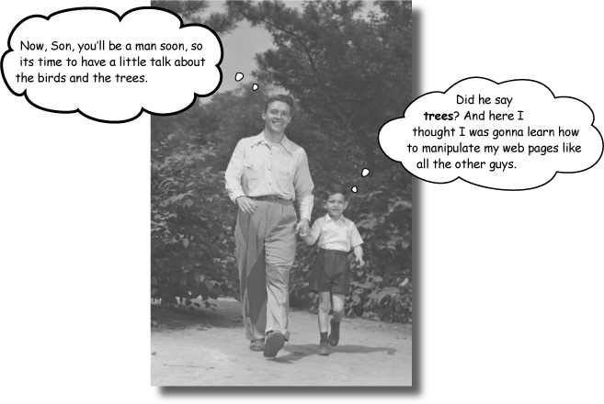
DOM
The Document Object Model (DOM) is a programming interface for HTML, XML and SVG documents. It provides a structured representation of the document as a tree. The DOM defines methods that allow access to the tree, so that they can change the document structure, style and content. The DOM provides a representation of the document as a structured group of nodes and objects, possessing various properties and methods. Nodes can also have event handlers attached to them, and once an event is triggered, the event handlers get executed. Essentially, it connects web pages to scripts or programming languages.

Slide 17
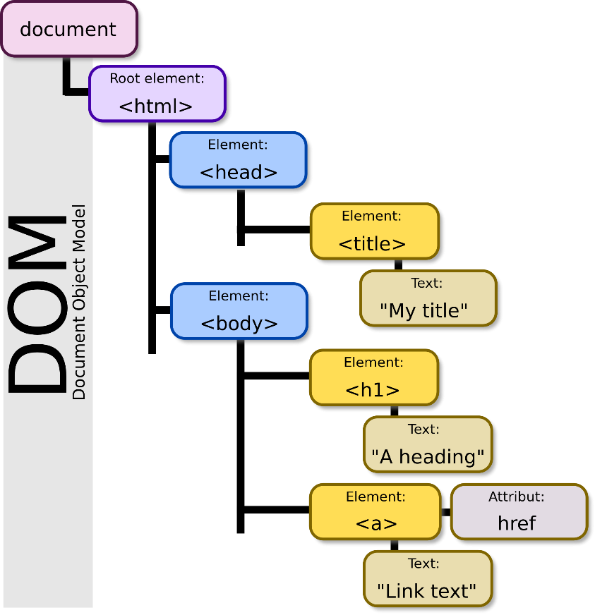
DOM - Nodes
The Document Object
When an HTML document is loaded into a web browser, it becomes a document object.
The document object is the root node of the HTML document and the "owner" of all other nodes: (element nodes, text nodes, attribute nodes, and comment nodes).
The document object provides properties and methods to access all node objects, from within JavaScript.
Tip: The document is a part of the Window object and can be accessed as window.document.

Slide 18
DOM – Nodes Types
Constant | Value | Description
Node.ELEMENT_NODE | 1 | An Element node such as <p> or <div>.
Node.TEXT_NODE | 3 | The actual Text of Element or Attr.
Node.PROCESSING_INSTRUCTION_NODE | 7 | A ProcessingInstruction of an XML document such as <?xml-stylesheet ... ?> declaration.
Node.COMMENT_NODE | 8 | A Comment node.
Node.DOCUMENT_NODE | 9 | A Document node.
Node.DOCUMENT_TYPE_NODE | 10 | A DocumentType node e.g. <!DOCTYPE html> for HTML5 documents.
Node.DOCUMENT_FRAGMENT_NODE | 11 | A DocumentFragment node.

Slide 19
Document Object Model (Properties)
Property | Description
doctype | Returns the Document Type Declaration associated with the document
head | Returns the <head> element of the document
body | Sets or returns the document's body (the <body> element)
anchors | Returns a collection of all <a> elements in the document that have a name attribute
cookie | Returns all name/value pairs of cookies in the document
documentElement | Returns the Document Element of the document (the <html> element)
forms | Returns a collection of all <form> elements in the document
images | Returns a collection of all <img> elements in the document
links | Returns a collection of all <a> and <area> elements in the document that have a href attribute
referrer | Returns the URL of the document that loaded the current document
URL | Returns the full URL of the HTML document
title | Sets or returns the title of the document
lastModified | Returns the date and time the document was last modified
scripts | Returns a collection of <script> elements in the document

Slide 20
Document Object Model (Methods)
Method | Description
getElementById() | Returns the element that has the ID attribute with the specified value
getElementsByClassName() | Returns a NodeList containing all elements with the specified class name
getElementsByName() | Returns a NodeList containing all elements with a specified name
getElementsByTagName() | Returns a NodeList containing all elements with the specified tag name
createElement() | Creates an Element node
createTextNode() | Creates a Text node
createAttribute() | Creates an attribute node
write() | Writes HTML expressions or JavaScript code to a document
writeln() | Same as write(), but adds a newline character after each statement
addEventListener() | Attaches an event handler to the document
removeEventListener() | Removes an event handler from the document
querySelector() | Returns the first element that matches a specified CSS selector(s) in the document
querySelectorAll() | Returns a static NodeList containing all elements that matches a specified CSS selector(s) in the document

Slide 21
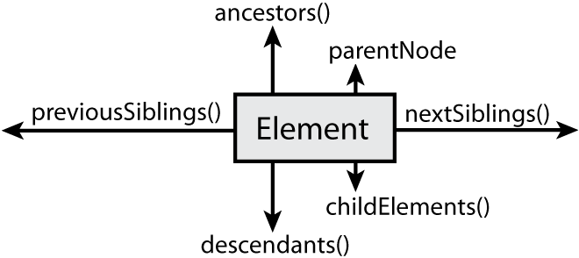
DOM – Elements
In the HTML DOM, the Element object represents an HTML element.
Element objects can have child nodes of type element nodes, text nodes, or comment nodes.
A NodeList object represents a list of nodes, like an HTML element's collection of child nodes.
Elements can also have attributes. Attributes are attribute nodes (See next chapter).

Slide 22
DOM – Elements (Properties)
Property | Description
id | Sets or returns the value of the id attribute of an element
className | Sets or returns the value of the class attribute of an element
childNodes | Returns a collection of an element's child nodes (including text and comment nodes)
attributes | Returns a NamedNodeMap of an element's attributes
firstChild | Returns the first child node of an element
lastChild | Returns the last child node of an element
nextSibling | Returns the next node at the same node tree level
previousSibling | Returns the previous node at the same node tree level
parentNode | Returns the parent node of an element
style | Sets or returns the value of the style attribute of an element
tagName | Returns the tag name of an element
childElementCount | Returns the number of child elements an element has

Slide 23
DOM – Elements (Methods)
1 | Description
addEventListener() | Attaches an event handler to the specified element
removeEventListener() | Removes an event handler
appendChild() | Adds a new child node, to an element, as the last child node
removeChild() | Removes a child node from an element
insertBefore() | Inserts a new child node before a specified, existing, child node
hasChildNodes() | Returns true if an element has any child nodes, otherwise false
setAttribute() | Sets or changes the specified attribute, to the specified value
removeAttribute () | Removes a specified attribute from an element
querySelector() | Returns the first child element that matches a specified CSS selector(s) of an element
querySelectorAll() | Returns all child elements that matches a specified CSS selector(s) of an element
getElementsByTagName() | Returns a collection of all child elements with the specified tag name
getElementsByClassName() | Returns a collection of all child elements with the specified class name

Slide 24
DOM – Elements (example)
var element, list, li, firstLi, lastLi;
function getList() {
list = document.getElementById('cities') ;
console.log(list) ;
}
function getFirstElement() {
// firstLi = list.firstChild ;
firstLi = list.firstChild.nextElementSibling ;
console.log(firstLi) ;
}
function changeText() {
var text = window.prompt("Enter a city: ") ;
firstLi.innerHTML = text ;
}
function deleteLastElement() {
// lastLi = list.lastChild.previousElementSibling ;
lastLi = list.lastElementChild ;
list.removeChild(lastLi) ;
}
<ul id="cities">
<li class="city-item">New York</li>
<li class="city-item">London</li>
<li class="city-item">Los Angeles</li>
<li class="city-item">Chisinau</li>
</ul>

Slide 25
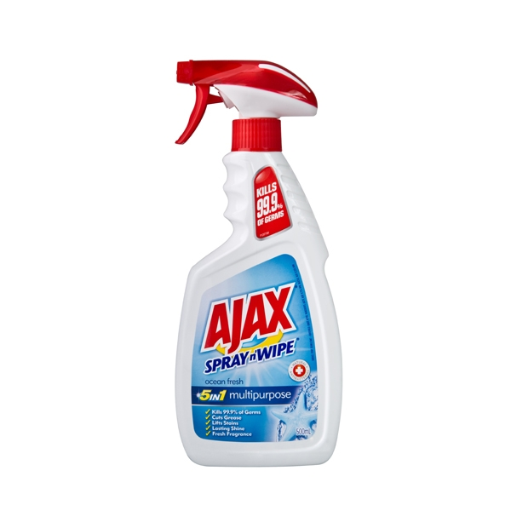
AJAX
Asynchronous JavaScript And XML

Slide 26
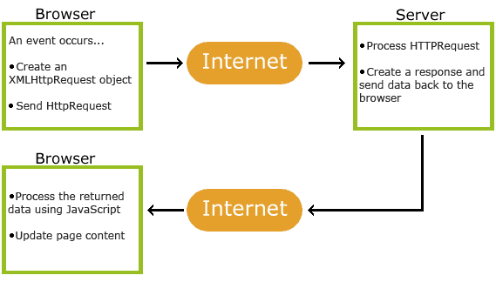
AJAX
AJAX is a technique for creating fast and dynamic web pages.
AJAX allows web pages to be updated asynchronously by exchanging small amounts of data with the server behind the scenes. This means that it is possible to update parts of a web page, without reloading the whole page.
Classic web pages, (which do not use AJAX) must reload the entire page if the content should change.
Examples of applications using AJAX: Google Maps, Gmail, YouTube, and Facebook.

Slide 27
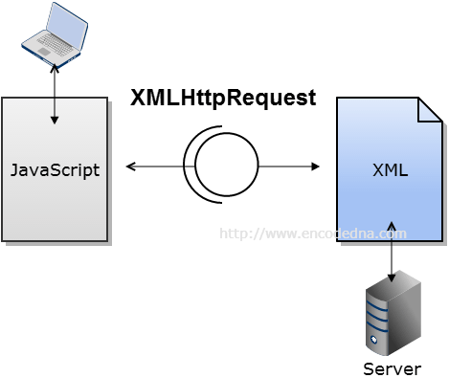
AJAX - XMLHttpRequest
AJAX is based on internet standards, and uses a combination of:
XMLHttpRequest object (to retrieve data from a web server)
JavaScript/DOM (to display/use the data)

Slide 28
AJAX – XMLHttpRequest (Properties & Methods & Events)
Property | Description
responseText | get the response data as a string
responseXML | get the response data as XML
Method | Description
open() | Specifies the type of request
send() | Sends the request to the server
setRequestHeader() | Adds HTTP headers to the request
Event | Description
onreadystatechange | Stores a function to be called automatically each time the readyState property changes
readyState | Holds the status of the XMLHttpRequest. Changes from 0 to 4
status | 200: "OK“, 404: Page not found …

Slide 29
AJAX – XMLHttpRequest (readyState)
0: request not initialized 1: server connection established 2: request received 3: processing request 4: request finished and response is ready

Slide 30

JSON
JavaScript Object Notation

Slide 31
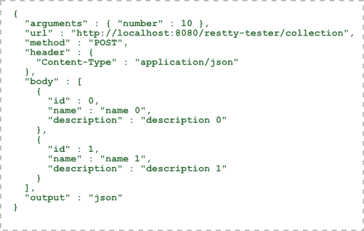
JSON
The JSON format is syntactically identical to the code for creating JavaScript objects.
Because of this similarity, a JavaScript program can easily convert JSON data into native JavaScript objects.
JSON Syntax Rules
Data is in name/value pairs
Data is separated by commas
Curly braces hold objects
Square brackets hold arrays

Slide 32
JSON – Serialization
var obj = { "employees" : [ { "firstName":"John" , "lastName":"Doe" },
{ "firstName":"Anna" , "lastName":"Smith" }, { "firstName":"Peter" , "lastName":"Jones" }
]
} ;
var text = '{ "employees" : [' + '{ "firstName":"John" , "lastName":"Doe" },' + '{ "firstName":"Anna" , "lastName":"Smith" },' + '{ "firstName":"Peter" , "lastName":"Jones" } ]}';
var text = JSON.strigify(obj);
var obj = JSON.parse(text) ;

Slide 33
Usefull Links
http://www.w3schools.com/jsref/obj_window.asp
http://www.w3schools.com/jsref/obj_history.asp
http://www.w3schools.com/jsref/obj_location.asp
http://www.w3schools.com/js/js_json.asp
http://www.w3schools.com/ajax/ajax_intro.asp

Slide 34



Thank you!
Mihai Gasper
AM Engineer
mihai.gasper@endava.com
+373 61 029 700
en_mgasper

